Slide 1
Fundamentals of Programming
Session 3

Slide 2
Agenda
Review Last Session
Lecture/Discuss Chapter 2
  Types, Variables, and Simple I/O
Programming Segment:
  Grade Assignment #2
  Work on Assignment #3

Slide 3
Introduction to Computer Programming
Chapter 2:
Types, Variables, and Simple I/O

Slide 4
Quotes and Strings
Basic printing was introduced in the last chapter.
Python provides other options for printing Strings
  A sequence of characters surrounded by “ “
  Note the quotes inside other quotes!
  Note the triple quoted string!

Slide 5
Escape Sequences with Strings
An escape sequence is a special sequence of characters that provide more functionality to the displayed text.
  \\ Backslash, prints one backslash
  \’ Single quote, prints one single quote
  \” Double quote, prints one double quote
  \a Bell, sounds the system bell
  \b Backspace, moves the cursor back one space
  \n Newline, moves the cursor to the beginning of next line
  \t Horizontal tab, Moves cursor forward one tab stop

Slide 6
Continue Printing On Same Line
print (“Steven”, “Dupay”)
Results in:
Steve Dupay
Notice the space between first and last name

Slide 7
Concatenating Strings
String concatenation means to join two or more strings into a single string.
The plus sign (+) is the string concatenation operator.
Example
  print (“Hello, ” + “my name is: ” + “Steven Dupay”)
  RESULTS IN:
  Hello, my name is: Steven Dupay

Slide 8
Repeating Strings
Strings can be repeated; multiple copies of the same string concatenated together
The multiplication sign (*) is the string repetition operator
Example:
  print (“John Doe ” * 3)
  RESULTS IN:
  John Doe John Doe John Doe

Slide 9
Working With Numbers
Two number types
  Integers (e.g. -3, -2, 0, 100123)
  Floating point (e.g. -23.2, 3.14159)
Integers and floats act differently under certain circumstances (shown later)

Slide 10
Working With Numbers
Python Operation | Arithmetic Operator | Algebraic Expression | Python Expression | Order of Evaluation
Exponentiation | ** | x^{y} | x ** y | Right -> left
Division | / | x ÷ y | x / y | Left -> right
Integer Division | // from __future__ import division | x ÷ y | x // y | Left -> right
Modulus | % | x mod y | x % y | Left -> right
Multiplication | * | xy | x * y | Left -> right
Addition | + | x + y | x + y | Left -> right
Subtraction | - | x – y | x – y | Left -> right

Slide 11
Working With Numbers
Be careful of the order of evaluation!
  Do what is in parentheses first!
  ** right to left
  *, /, % left to right
  +, - left to right

Slide 12
Understanding Variables
So far the example programs have not used memory
  direct printing
  direct expression evaluation
How are values stored in memory?

Slide 13
Understanding Variables
A variables is a named location in memory that can hold a value of a given type
Memory (RAM) is similar to a series of mailboxes
  Each has address
  Each can hold a value
1 GB
x
10
…
name
“Sarah”
0

Slide 14
Understanding Variables
Naming Variables
  Legal variable names
    Can only contain letters, numbers, and underscores
    Can’t start with a number
  Good variable names
    Choose descriptive names
    Be consistent
    Follow the traditions of the language
    Keep the length in check

Slide 15
Understanding variables
Five attributes (characteristics) of a variable:
  Name
  Data type
  Value
  Length (bytes)
  Address (memory location)

Slide 16
Good variable names
Use 3 characters to denote data type
  str for string int for integer flt for float
Two basic conventions:
  Microsoft Open Source
    strName=“Steve” str_name=“Steve”
    intAge=25 int_age=25
    fltIntRate=6.5 flt_intRate=6.5

Slide 17
Understanding Variables
Variables must be created first
  Use assignment statement to create a variable and assign a value to it
  Assignment operator is =
Example
  intAge = 10
  strName = “Sarah”

Slide 18
Understanding Variables
Using Variables
  Once created, it refers to some value
  Use a variable as you would a value
Example
  strName = “Sarah”
  print (strName)
  Sarah

Slide 19
Getting User Input
How do we get user input?
  What function do we use?
  What types does it use? Strings? Integers?
  What do we do with the input?
Use the Python function input()
Example
  strName = input(“Please enter your name ”)

Slide 20
Getting User Input
The input function returns a string.
  Be careful!
    10 is not the same as “10”
    Other functions convert strings to integers and vice versa.
  strFname = input(“Enter your first name”)

Slide 21
String Methods
Example: Quotation Manipulation
  upper()
  lower()
  title()
  And more………..

Slide 22
String Methods
upper() Returns the uppercase version of the string
lower() Returns the lowercase version of the string
swapcase() Returns a new string where the case of each letter is switched
capitalize() Returns a new string with the first letter capitalized and remaining letters are in lowercase
title() Returns a new string with the first letter of each word capitalized and all other letters are in lower case

Slide 23
Using the Right Types
Example: Trust Fund Buddy - Bad
Shows an example of a logic error
  An error that does not cause your program to crash, but a flaw in the design of the solution
  This example just concatenates strings
+ for strings and + for addition is an example of operator overloading

Slide 24
Converting Values
String values can be converted to integers using the built-in int() function
  Examples
  intAge = int( “10” )
  strAge = input(“Enter your age: ”)
  intAge = int( strAge )
  intAge = int(input(“Enter your age: “))

Slide 25
Converting Values
String values can be converted to floating points using the built-in float() function
  Examples
  fltRate = float(“14.5”)
  strRate = input(“Enter interest rate: ”)
  fltRate = float(strRate)
  fltRate = float(input(“Enter interest rate:“))

Slide 26
Converting Numbers to string
It is simple to convert either float or integer to string by using the built-in str function
strAge = str(intAge)
strTax = str(fltTax)

Slide 27
Converting Values
Ints and floats can be converted to string values str() function
  Example
  first4 = 1234
  second4 = 5678
  third4 = 2468
  fourth4 = 3579
  card_number = str( first4 ) + str( second4) + str ( third4 ) + str( fourth4 )
  ‘1234567824683579’

Slide 28
Other Assignment Operators
Augmented assignment operators
A combination of assignment and a mathematical operation
  Operator Example Is Equivalent
*= x *= 5 x = x * 5
/= x /= 5 x = x / 5
%= x %=5 x = x % 5
+= x += 5 x = x + 5
-= x -= 5 x = x - 5

Slide 29
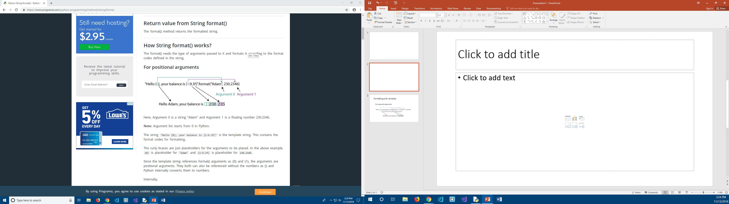
Formatting Output (by position)

Slide 30
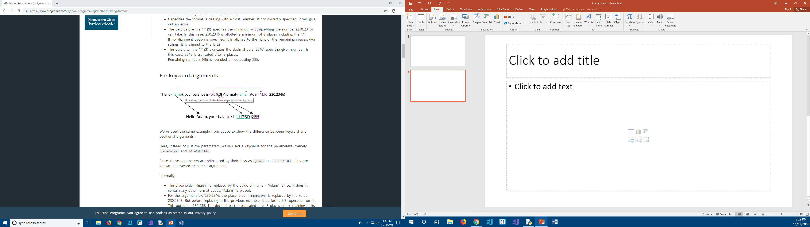
Formatting Output (with variables)

Slide 31
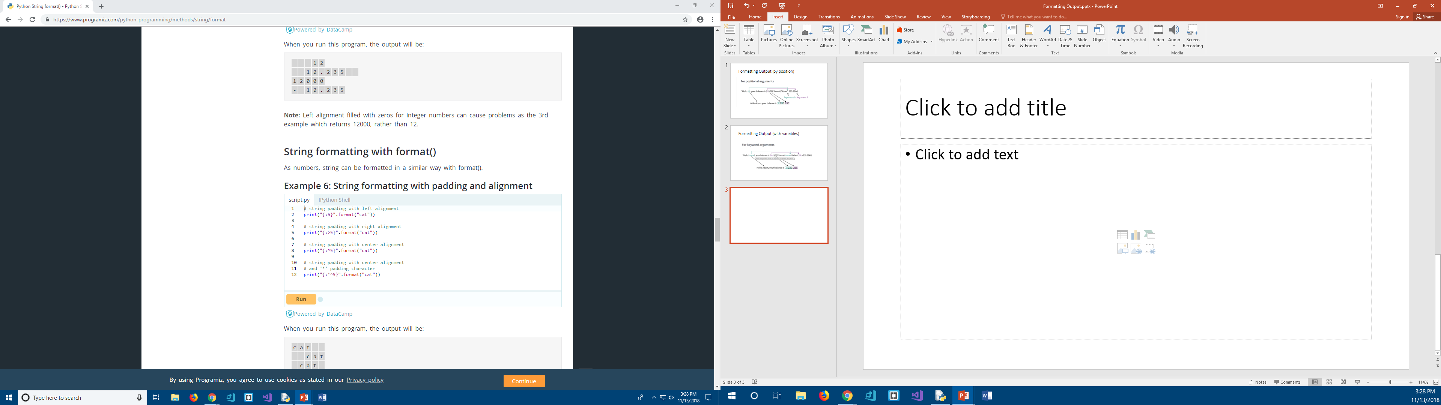
String Formatting (padding and alignment)

Slide 32
Formatting Tutorial Links
https://pyformat.info/#number
https://www.programiz.com/python-programming/methods/string/format

Slide 33
Assignments
Read Chapter 3 & 4
  Control Structures
Programming Segment:
  Grade Assignment #2
  Work on Assignment #3

